Slide 1


Presented by Sanchita
Live Job Listings & Salary Prediction
Real-time data | Machine Learning | Streamlit Dashboard
https://github.com/Sanchita-S/Final_Project

Slide 2



Project Overview
Objective: To collect real-time job data from Adzuna, predict average salaries using machine learning, and build an interactive dashboard using Streamlit for job market insights.
Target Audience: Job seekers, data analysts, recruiters, and HR managers.
Tools: Adzuna API, Python, Pandas, Scikit-learn, Streamlit, Plotly
Target Region: Canada + USA

Slide 3

Main challenges identified
Initial Attempt: Scraping job listings from Glassdoor using Selenium
Problems Faced:
Aggressive bot detection on Glassdoor
Frequent IP blocks and timeouts
Selenium selectors failing due to dynamic loading
Result:
Inconsistent, unreliable data
Spent hours debugging with little success
Decision: Switched to API-based solution for better reliability and data quality
01.

Slide 4
Main challenges identified
Attempted Remotive API
Why We Tried It:
Remotive offers a remote job API
Easy to access without authentication
Issues Faced:
Very limited data returned
No salary fields in most job listings
Filtering by title or location was weak
Result:
Could not use it for model training or analysis
Pivoted to Adzuna which provided structured, complete job data
02.

Slide 5

Data Collection with Adzuna
Why Adzuna Helped:
Free public job search API
No IP bans or scraping issues
Reliable structure with JSON responses
How It Works:
We passed keywords like "Data Analyst", and locations like Canada/US
Adzuna returned structured job listings: title, company, salary_min/max, description, job URL
What It Did for Us:
Enabled us to gather thousands of real-time job listings
Gave access to salary info we could use for model training
Provided clean URLs to real job pages for dashboard users

Slide 6
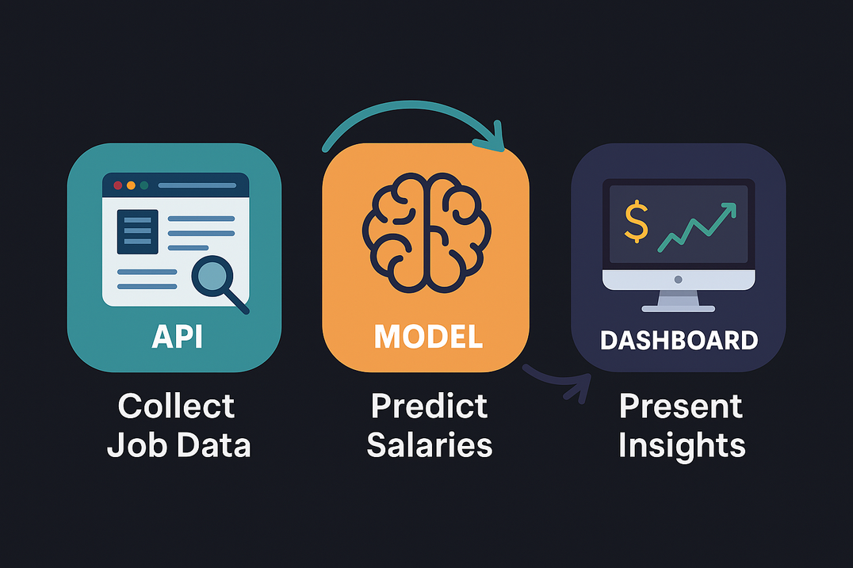
Process Flow
Step 1: API – Adzuna
Real-time job listings
Clean, structured JSON output
⬇️
Step 2: Data Processing & ML
Cleaning and feature engineering
Random Forest Regression model
⬇️
Step 3: Streamlit Dashboard
Interactive UI with filters
Tabs, charts, predictions, job links

Slide 7

Data Cleaning
01.
API: Adzuna Job Search
Job title, location, salary_min/max, company, link
Collected 8000+ job listings
Challenges:
Missing salaries, unstructured data
Fix:
Filtered incomplete entries
Pulled extra samples
02.
Steps Taken:
Removed duplicates
Calculated avg_salary
Feature engineering: is_senior, is_junior, location codes
Challenge: Title inconsistency
Fix: Keyword-based tagging (e.g., “senior”, “entry”)

Slide 8
Model Results
Processing Summary from Google Colab:
🔁 Duplicate listings: 1980
❌ Listings missing company name: 47
✅ Duplicates removed, remaining: 6965
📦 Total jobs fetched: 6965
💼 Jobs with valid salary data: 6083
✅ Cleaned dataset saved to 'cleaned_job_data.csv'
Test Sample Predictions:
Predicted vs Actual Salary Chart (line chart)
Sample rows:
Predicted: $97,416 | Actual: $96,811
Predicted: $115,794 | Actual: $92,483
Model Performance:
✅ Test Set Accuracy: 79.37%
✅ Full Dataset Accuracy: 83.74%
💾 Predictions saved to 'full_salary_predictions.csv'

Slide 9
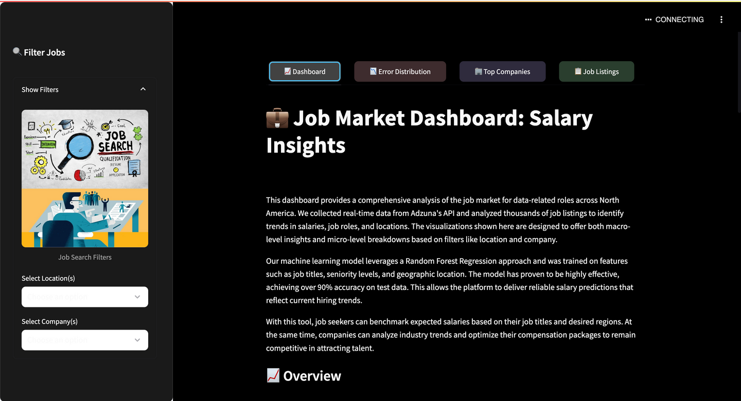
Streamlit Dashboard
4-tab layout:
Overview
Error Distribution
Top Companies
Job Listings
Sidebar filters for company/location
Custom dark theme, pastel tabs, line and bar charts

Slide 10
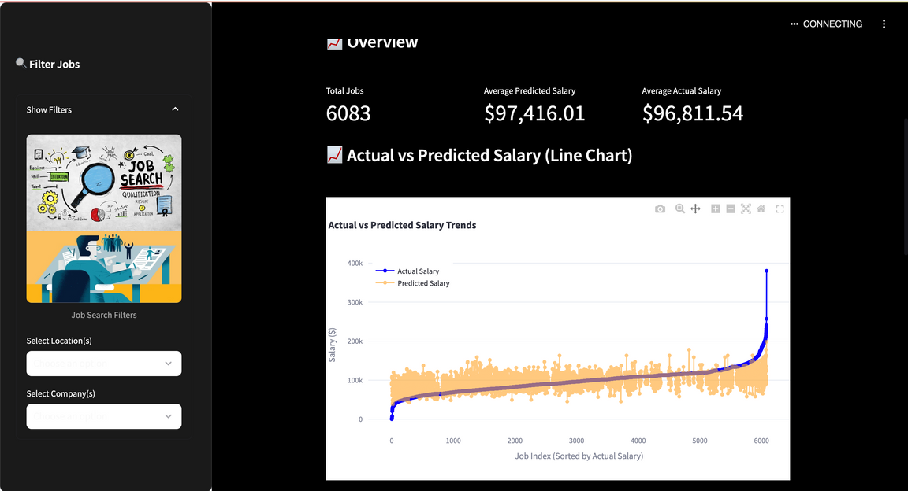
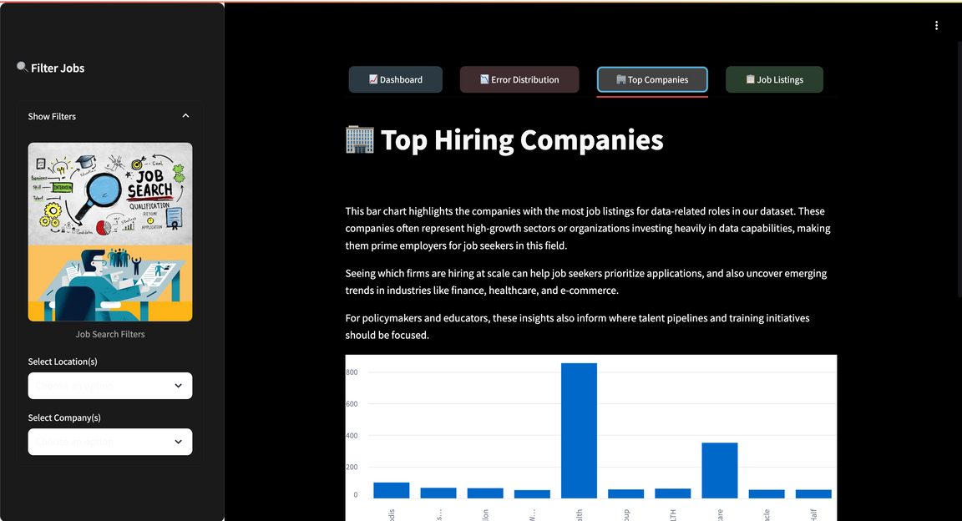
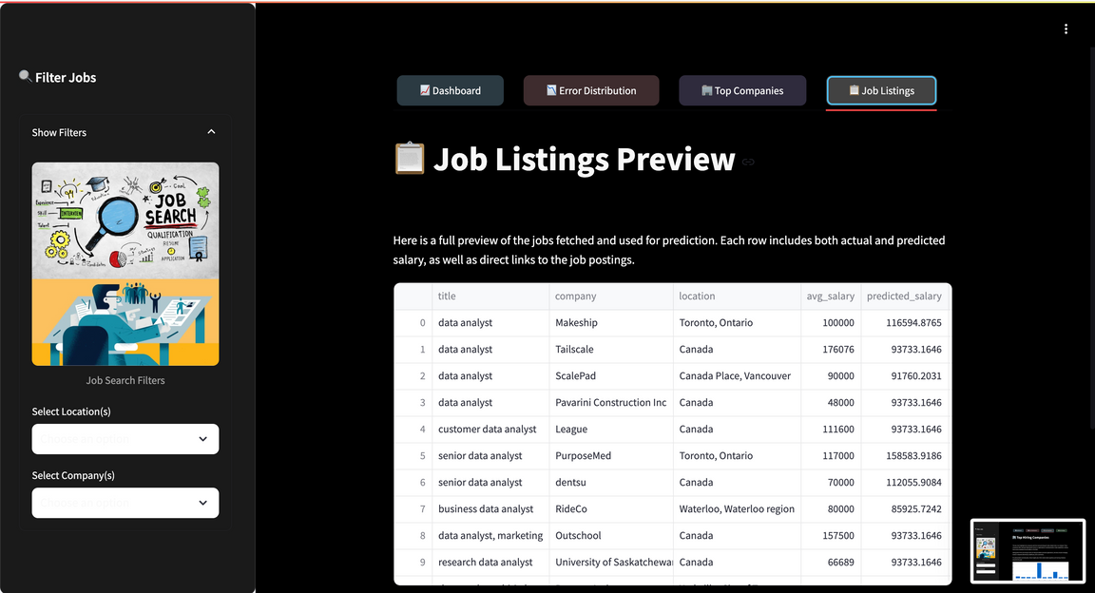
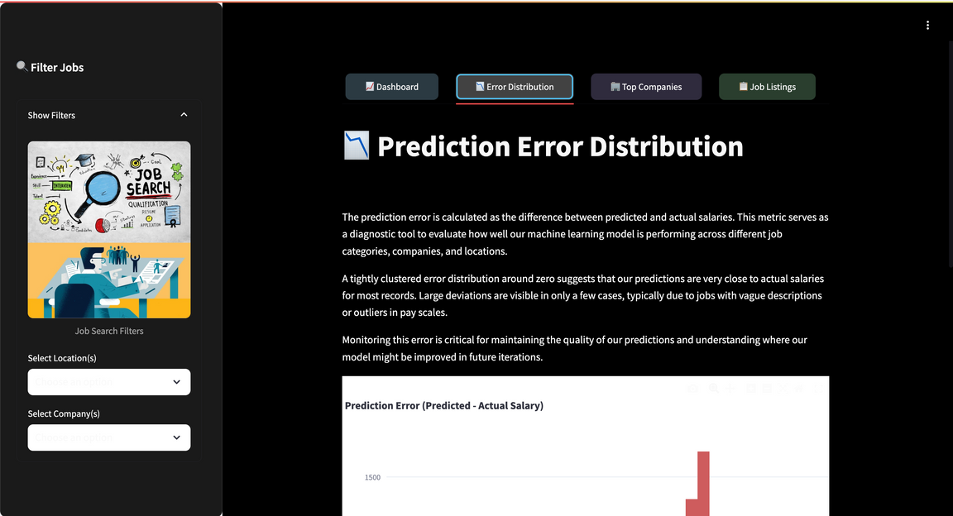
Dashboard Screens

Slide 11
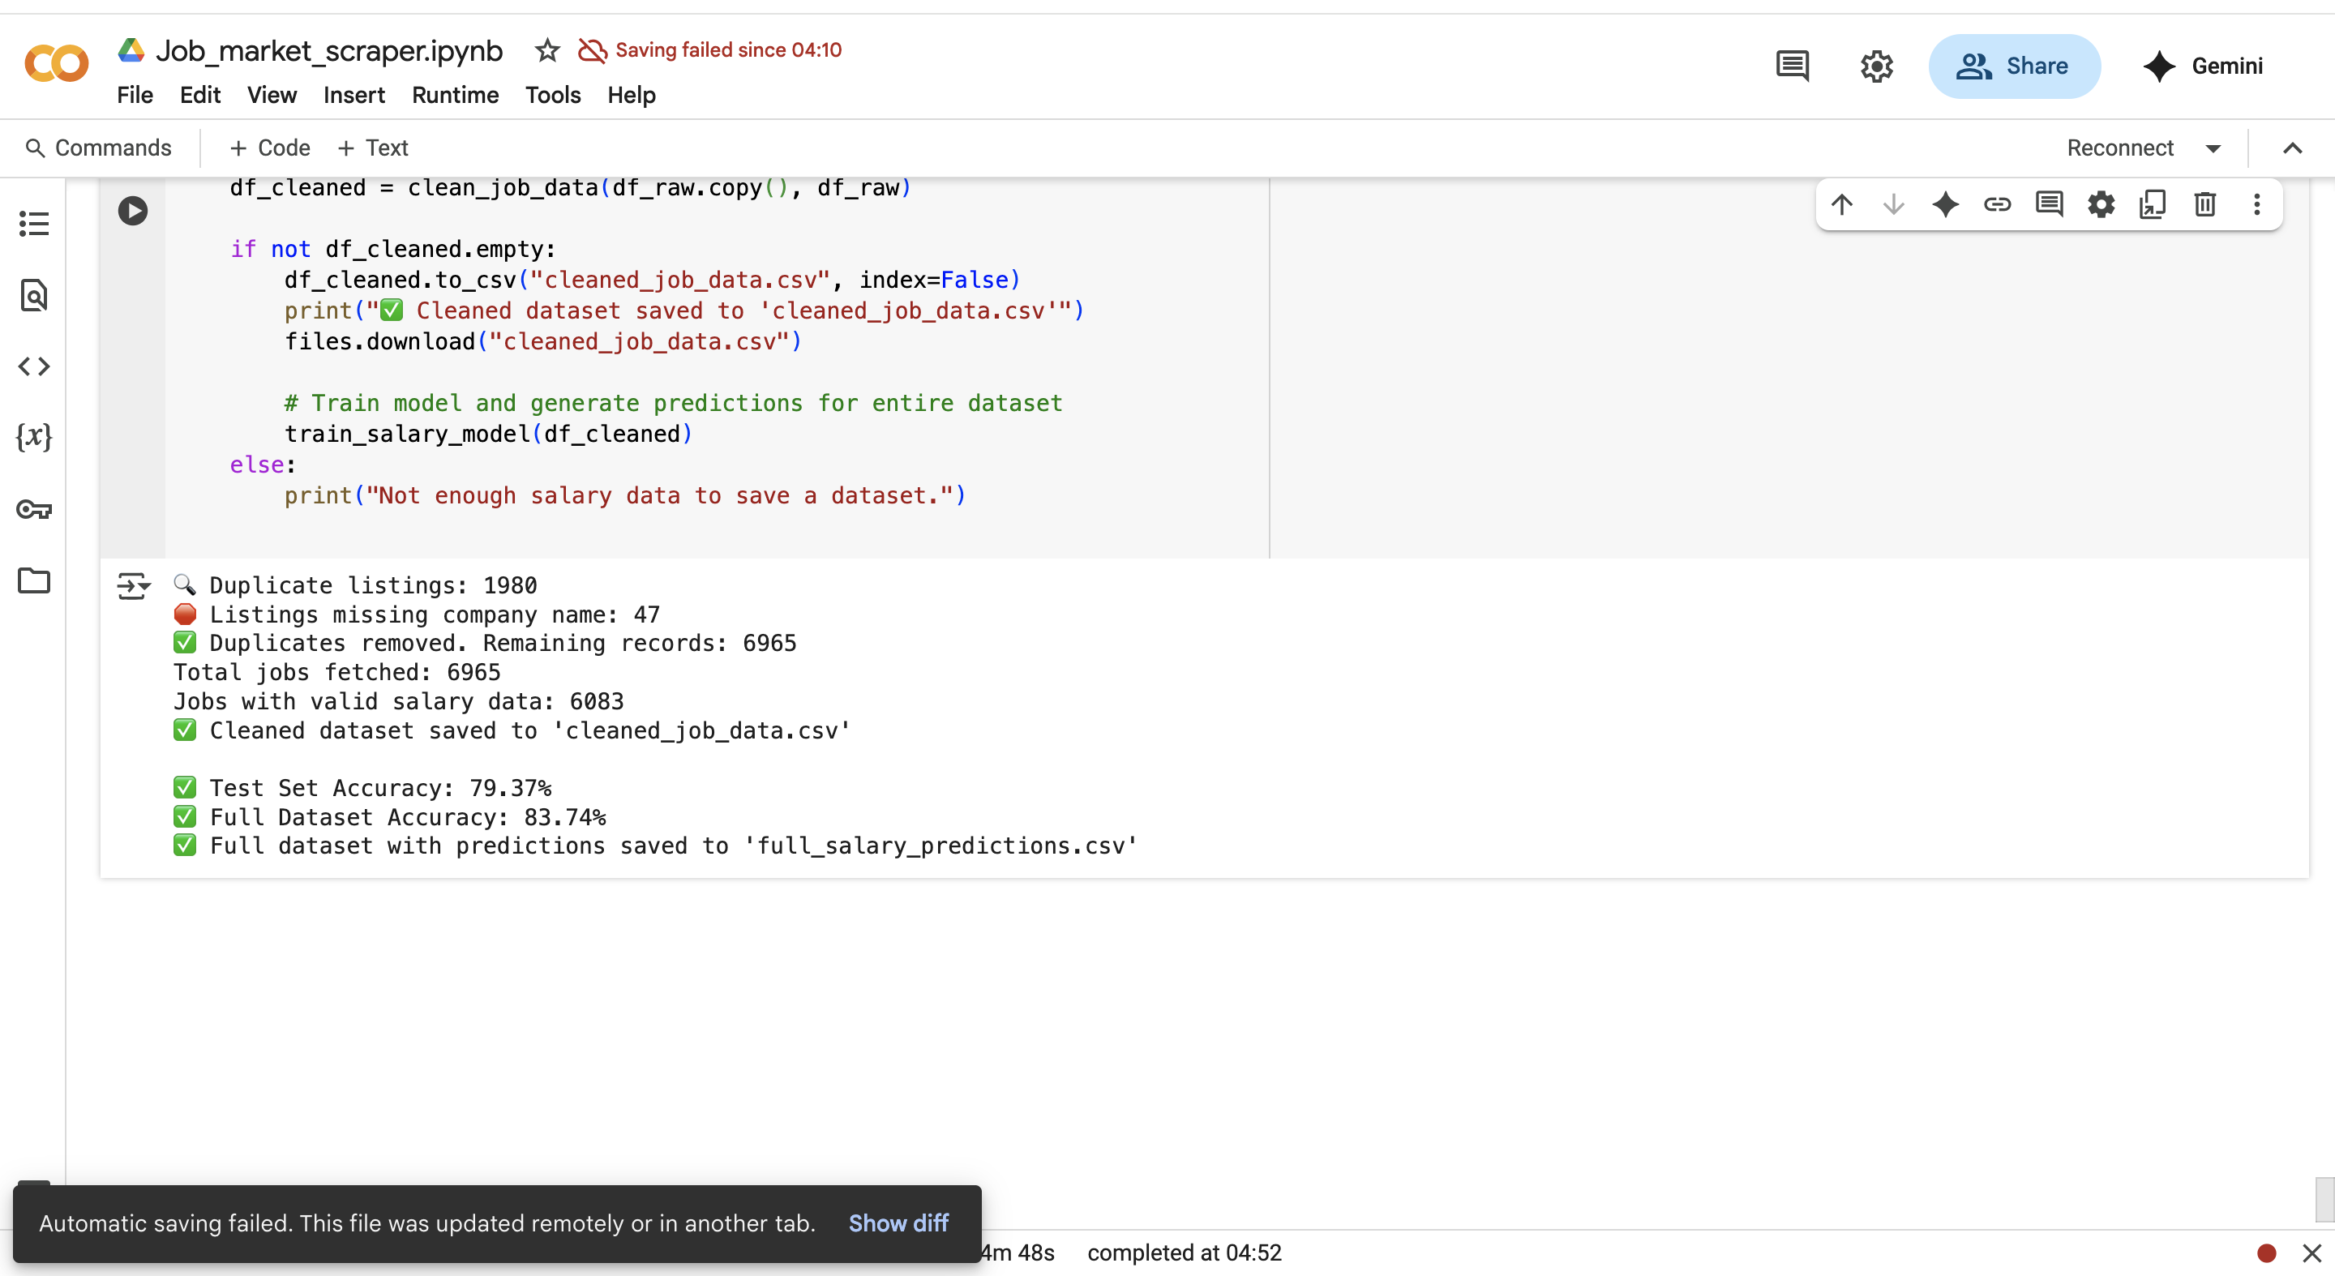

Slide 12

Presented by Sanchita
Thank you very much!

